Slide 1
Unveiling Spring Boot & Building Your First Application
PPT-Master Version 01. There will be an extensive update with the new Deutsche Bank font and sample charts at the end of August 2024.
8 May 2024, Speaker name

Slide 2

Introduction
Open Source Java Framework for WebApps & microservices
a. Autoconfiguration
b. Pre-configuried dependency bundle
c. Spring + Web Server = Spring Boot
d. Streamlines Spring application setup

Slide 3
Why not Spring?
spring-boot-starter-web
1. Simplifies significantly, need one dependency:
2. It automatically add necessary dependencies during the build.
3. Convention over Configuration.
4. Features include embedded servers, metrics, health checks.

Slide 4
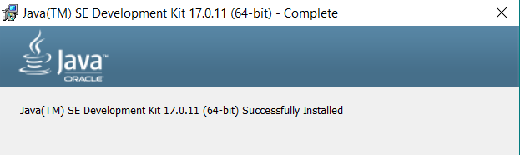
Setting up Java
1. Download Java JDK 17 from official Java website (Link below).
https://www.oracle.com/java/technologies/downloads/#java17
2. Double click downloaded file and follow the onscreen instructions for installation.

Slide 5
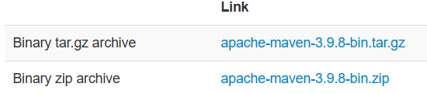
Setting up Apache Maven
Download the binary file from : https://maven.apache.org/download.cgi
Step 1: Extract the downloaded ZIP file
Step 2: Move the extracted folder to the desired location
(e.g., C:\apache-maven-3.9.8)
Step 3: Add apache-maven-3.9.8 to System PATH

Slide 6
Getting SpringBoot CLI
Prerequisites:-
Java Development Kit (JDK): Ensure JDK 17
Apache Maven 3.9.8
Homebrew (for Mac): Optional but recommended for easy installation
Installation:-
Navigate to the Spring Boot CLI section on the Spring website
Download Link:
https://docs.spring.io/spring-boot/installing.html#getting-started.installing.cli

Slide 7
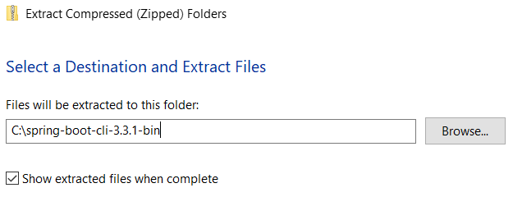
Installation on Windows
Step 1: Extract the downloaded ZIP file
Step 2: Move the extracted folder to the desired location (e.g., C:\SpringBootCLI)
Step 3: Add Spring Boot CLI to System PATH

Slide 8
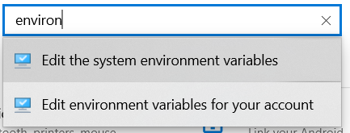
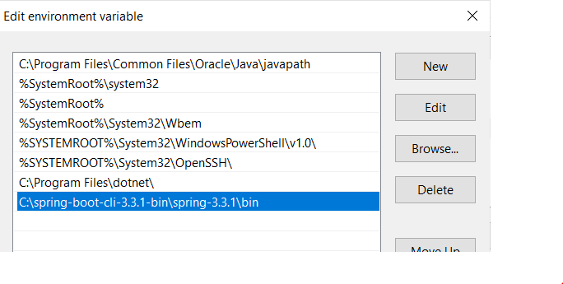
Add Spring Boot CLI to System PATH
Type environment variables on search bar
Path to your spring boot cli installation
Click on New to add

Slide 9
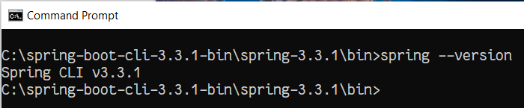
Post-Installation Steps
Testing: Run a simple Spring Boot command to ensure the CLI is working correctly
Example Command:
spring --version

Slide 10

On Your First “Hello World” :)
What is Spring Initializr?
An online tool to generate Spring Boot project structures
Key features : dependency management and project configuration
Accessing Spring Initializr
Navigate to the Spring Initializr website (https://start.spring.io)
Note : Spring Initializr is also integrated into IDEs such as IntelliJ IDEA or VScode

Slide 11
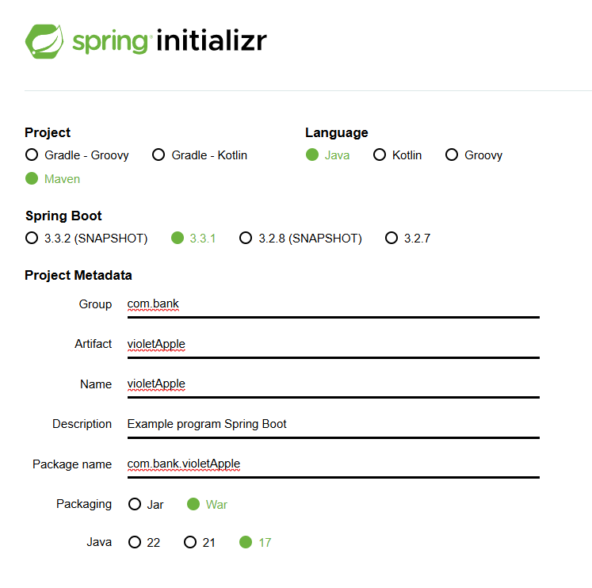
Start New Project
Project Type: Choose Maven
Language: Select Java
Spring Boot Version: Select the appropriate version of Spring Boot eg. 3.3.1

Slide 12
Metadata Fields
Group: Typically the domain of your organization (e.g., com.banking)
Artifact: The name of your project
Name: The display name for your project
Description: A brief description of your project
Package Name: The base package for your application
Packaging: Choose War
Java Version: Select the version of Java you will be using
(e.g., Java JDK 17)

Slide 13

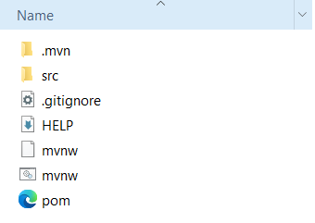
Generating the Project
1. Generate Button: Click on the "Generate" button to download the project zip file
2. Download and Extract: Download & extract the generated zip file

Slide 14
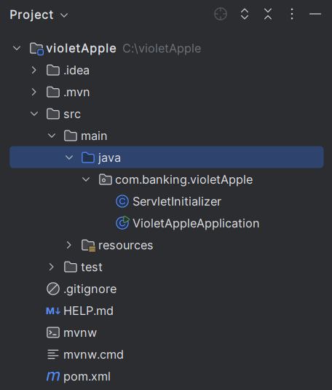
The Project Structure
Overview of the key files and folders in the generated project
src/main/java:
Contains application code
src/main/resources:
Contains configuration files and static resources
pom.xml:
Dependency management files

Slide 15
Importing the Project into an IDE
Step-by-Step Guide: Instructions for importing the project into popular IDEs
IntelliJ IDEA: File -> New -> Project from Existing Sources -> Select the project
Eclipse: File -> Import -> Existing Maven/Gradle Project -> Select the project
VS Code: Open Folder -> Select the project folder

Slide 16
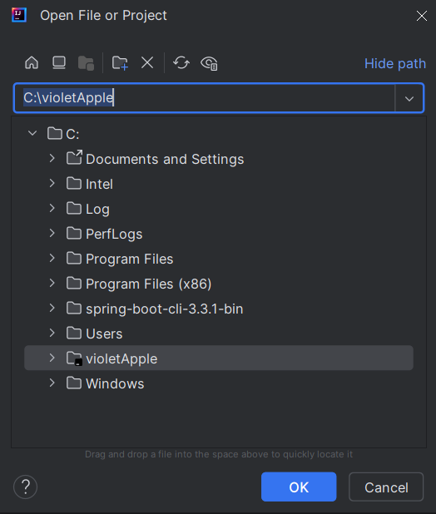
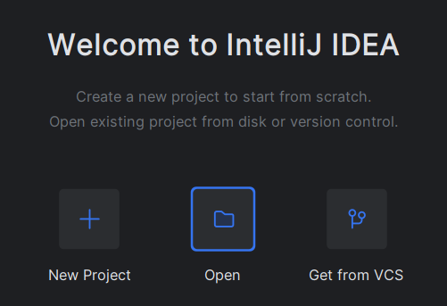
IntelliJ IDEA
Open -> Select the folder of project -> Ok

Slide 17
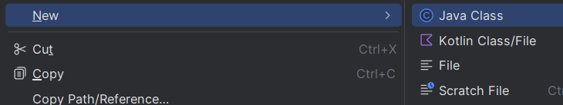
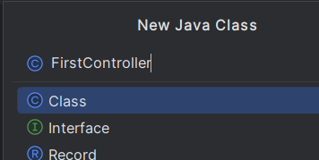
Get into first code
Create a new Java Class file
Give a meaningful name

Slide 18
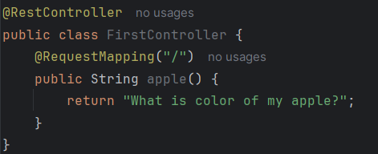

First Code
Click on run buttion to run your first application

Slide 19
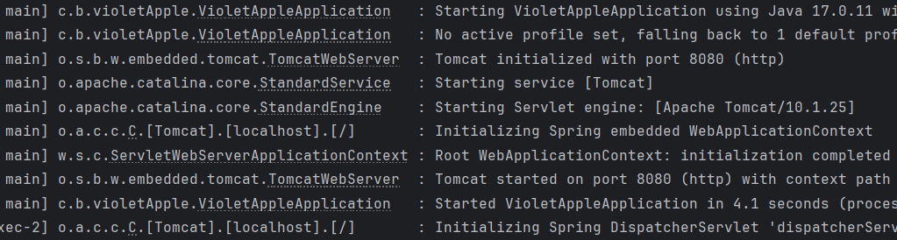
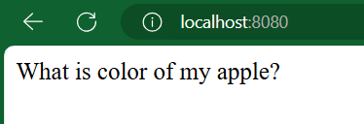
Default run on localhost:8080
Output on web browser

Slide 20
Inversion of Control (IoC)
Definition:
IoC transfers control of objects or program portions to a container or framework.
Traditional vs. IoC:
In traditional programming, custom code controls program flow.
In IoC, an external entity (the IoC container) manages flow and object creation.

Slide 21
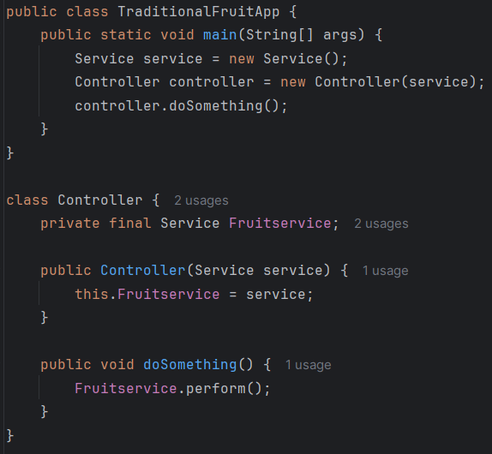
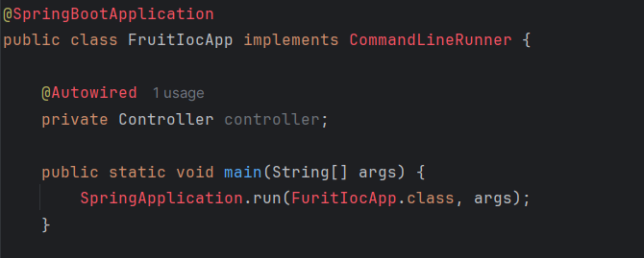
IoC Example
manually instantiate the Service and Controller classes
Automatically injects the dependencies using annotations like @Autowired
- Decoupling the Class from the creation process

Slide 22
Dependency Injection (DI)
Definition:
Dependency Injection (DI) is a design pattern that implements IoC.
Benifits:
DI makes the code more modular and easier to test by allowing dependencies to be swapped out.
It also promotes loose coupling

Slide 23
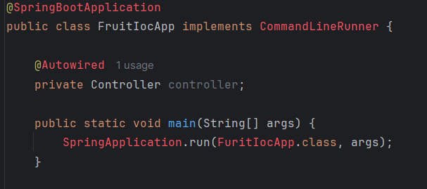
Dependency Injection Example
A Spring Boot example where a service class is injected into a controller class using the @Autowired annotation

Slide 24
Loose Coupling
Loose coupling refers to a design principle where components or classes are minimally dependent on each other.
1. Easier Maintenance: Components can be updated or replaced with minimal impact on others.
2. Better Scalability: Systems can be scaled more easily because components are independent.
3. Flexibility: New features or changes can be integrated without significant refactoring.

Slide 25

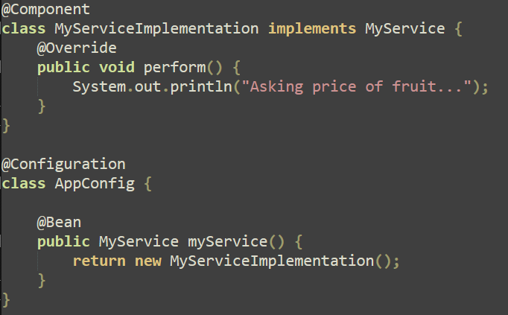
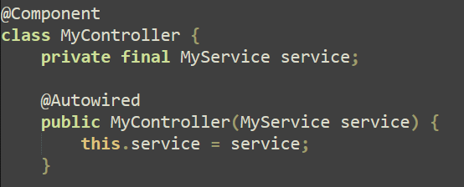
Loose Coupling Example
MyService is an interface, and MyServiceImplementation is its implementation.
The MyController class depends on the MyService interface rather than a concrete implementation, promoting loose coupling.

Slide 26
Tight Coupling
Tight coupling refers to a design where components or classes are highly dependent on each other.
1. Reduced Flexibility: Difficult to modify or replace components without affecting others.
2. Harder Maintenance: More effort is required to update and maintain the system.
3. Increased Risk of Changes Propagating: Changes in one part of the system can cause issues in other parts, making debugging and testing more complex.

Slide 27
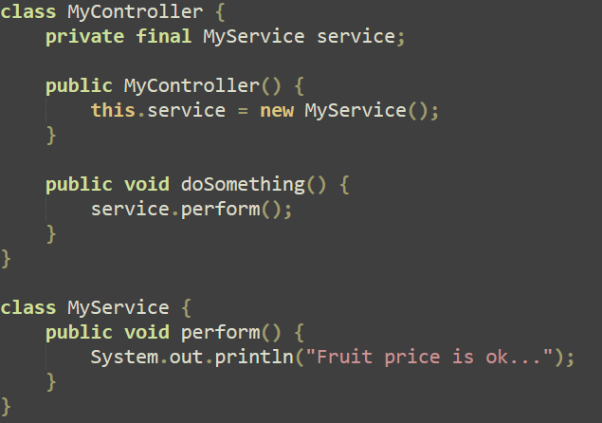
Tight Coupling Example
The MyController class directly creates an instance of MyService, leading to tight coupling.
If the implementation of MyService changes or if you want to swap it out for another implementation, you would need to modify the MyController class.

Slide 28
Unveiling
Spring Boot &
Building Your First Application
Module 2
PPT-Master Version 01. There will be an extensive update with the new Deutsche Bank font and sample charts at the end of August 2024.
8 May 2024, Speaker name

Slide 29

Spring Boot Autoconfiguration: Unveiling the Magic
How Spring Boot Automatically Configures Beans Based on Project Dependencies

Slide 30
What is Spring Boot Autoconfiguration?
1. Autoconfiguration simplifies Spring application setup.
2. Automatically configures Spring beans based on classpath settings, other beans, and property settings.
3. Reduces boilerplate configuration.
(For instance, if H2 is present in your classpath and you haven't manually set up any database connection beans, Spring Boot will automatically configure an in-memory database.)
Spring Application
Auto configuration
Dependencies
Spring Boot Application

Slide 31
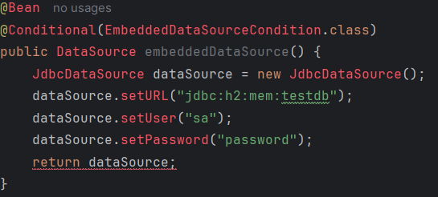
How Does It Work?
1. Spring Boot scans the classpath for dependencies.
2. Conditional configuration based on available libraries and classes.
3. Utilizes @Conditional annotations for decision-making.
Conditionally configure beans based on certain conditions

Slide 32
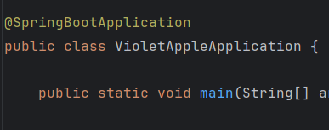
Example: DataSource Autoconfiguration
1. Detects DataSource class in the classpath.
2. Configures DataSource bean if not already defined..
3. Annotated with @SpringBootApplication to enable auto-configuration.
Maven Dependency (pom.xml)
<dependency>
<groupId>org.springframework.boot</groupId>
<artifactId>spring-boot-starter-data-jpa</artifactId>
</dependency>
<dependency>
<groupId>com.h2database</groupId>
<artifactId>h2</artifactId>
<scope>runtime</scope>
</dependency>
application.properties
spring.datasource.url=jdbc:h2:mem:testdb spring.datasource.driver-class-name=org.h2.Driver spring.datasource.username=sa spring.datasource.password=password spring.h2.console.enabled=true

Slide 33

Utilizing Powerful Annotations in Spring Boot
Introduction to Annotations in Spring Boot
1. Annotations simplify configuration and setup.
2. Central to Spring Boot's philosophy of convention over configuration.
3. Focus on three powerful annotations:
@SpringBootApplication, @Configuration, @Bean.

Slide 34
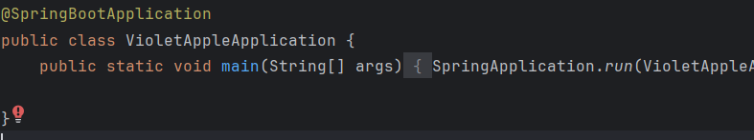
Understanding @SpringBootApplication
Combines @Configuration, @EnableAutoConfiguration, and @ComponentScan.
Marks the main class of a Spring Boot application.
Simplifies application setup.

Slide 35
Breaking Down @SpringBootApplication
@Configuration: Marks a class as a source of bean definitions.
@EnableAutoConfiguration: Enables Spring Boot’s autoconfiguration mechanism.
@ComponentScan: Scans for Spring components in the package.
@EnableAutoConfiguration
@Configuration
@SpringBootApplication
@ComponentScan

Slide 36
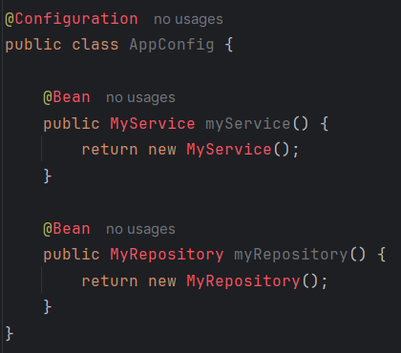
The @Configuration Annotation
Indicates that a class declares one or more @Bean methods.
Used for defining beans and configuration settings.
Essential for Java-based configuration.
@Configuration: Indicates that the class contains one or more bean definitions
@Bean: Marks a method as a bean producer, and the method's return value will be managed by the Spring container.

Slide 37
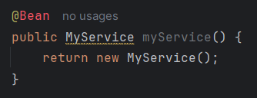
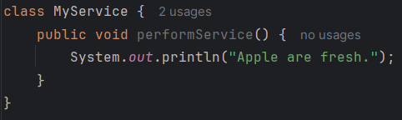
The @Bean Annotation
Marks a method as a bean definition..
Beans are managed by the Spring container.
Allows custom bean creation and configuration.
@Bean: Marks the myService method as a bean producer, meaning that Spring will manage the instance returned by this method.
This snippet defines a single bean, MyService, which will be instantiated and managed by Spring. The MyService class includes a simple method performService.

Slide 38

Understanding
Maven in Spring Boot
8 May 2024, Speaker name

Slide 39
What is Maven?
Maven is a powerful project management tool.
Manages project dependencies and builds lifecycle.
Ensures consistency and reproducibility in builds.

Slide 40
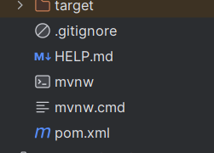
Maven in Spring Boot
Default dependency management tool in Spring Boot.
Simplifies configuration and dependency management.
Uses pom.xml to manage project dependencies.
Spring Boot gives you a bunch of starter pom which make it super easy to add jars to your ClassPath.

Slide 41
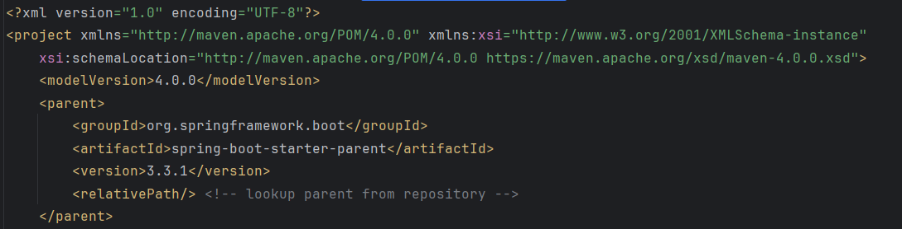
Understanding pom.xml
Project Object Model (POM) file.
Central configuration file for Maven projects.
Defines project dependencies, plugins, and configurations.
snippet of a pom.xml file

Slide 42
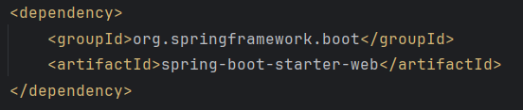

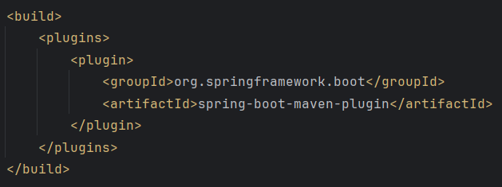
Key Sections in pom.xml
<dependencies>: Lists all project dependencies.
<properties>: Defines project properties
<build>: Configures build process and plugins.

Slide 43
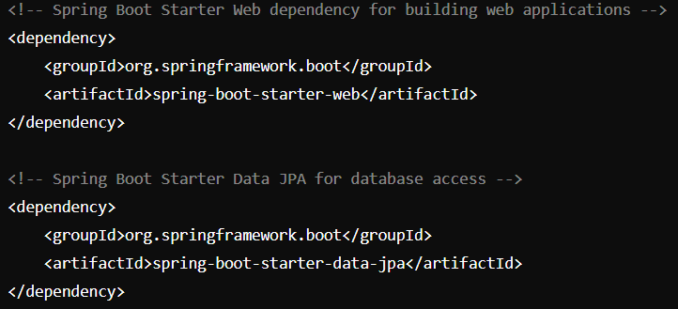

Managing Dependencies
Adding dependency in pom.xml file
Specifying versions

Slide 44
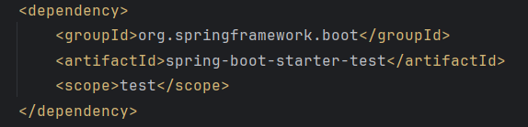
Understanding Dependency Scope
compile: Dependency is available in all classpaths.
provided: It is available only at compile-time, not runtime.
runtime: It is available only at runtime.
test: Only available in testing.
Snippet showing scope

Slide 45
Introduction to Spring Boot Logging
Logging is the process of recording information about a program’s execution, which helps in debugging and monitoring.
Configures Logback as the default logging framework.
Includes Logback and SLF4J dependencies by default.

Slide 46
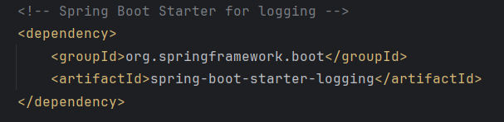

Configuring Logging in Spring Boot
Logging settings can be configured in application.properties
Each log level indicates the severity of the messages: ERROR (most severe), WARN, INFO, DEBUG, TRACE (most detailed)
Adding Spring boot Logging dependency
Example configuration in the application.properties

Slide 47
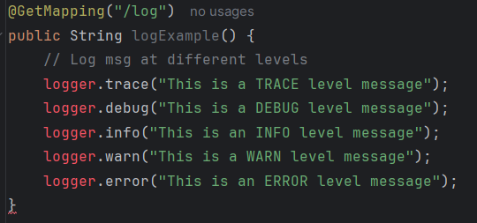
Example usage of logging
Depending upon the severity, use the appropriate logging level

Slide 48
Introduction to Spring Boot Admin
An open-source project designed to help manage and monitor Spring Boot applications
Keep track of various aspects of applications in real time.
Managing Application Properties and Environment.

Slide 49
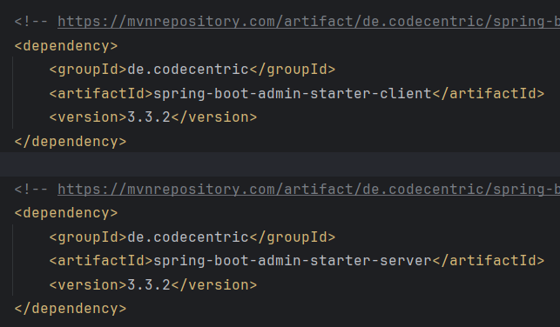
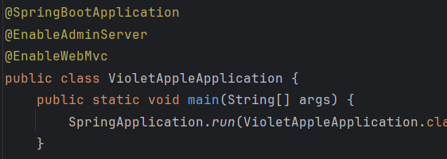
Setting Up Spring Boot Admin
Add Dependency: Include the spring-boot-admin-starter-server dependency in your Spring Boot application’s pom.xml
Add to application.properties
Add the @EnableAdminServer annotation to your main application class to enable admin server features.

Slide 50
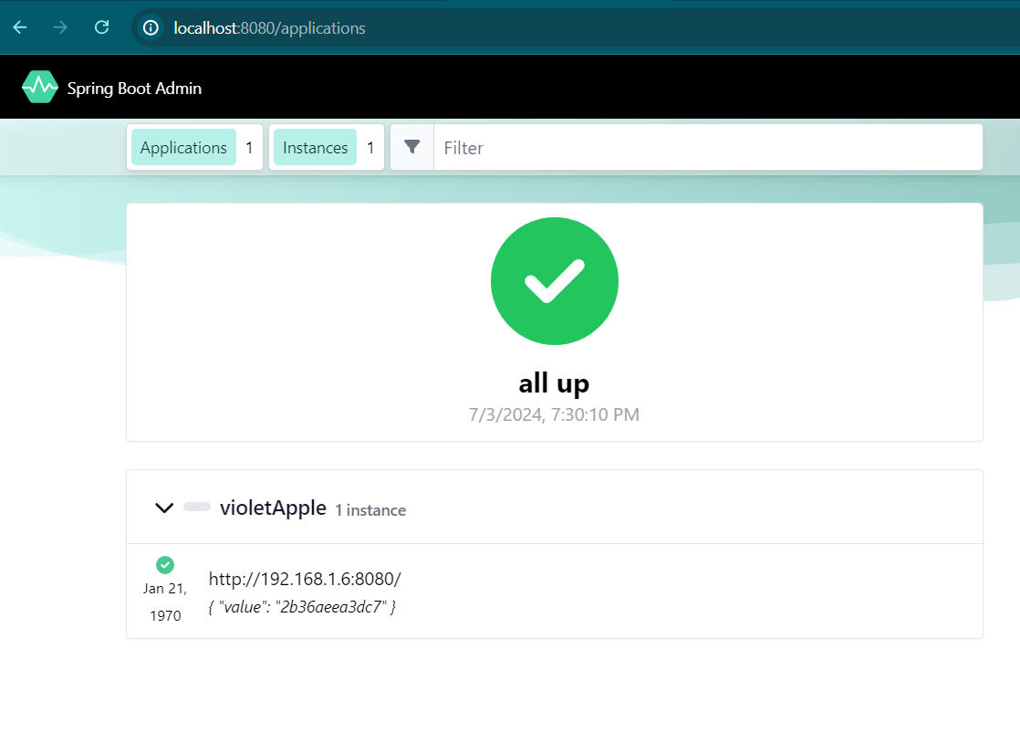
Monitoring and Managing
By default runs on localhost:8080
Registered application will be seen
Application is online

Slide 51
Starting with Zipkin
Zipkin is an open-source distributed tracing system that helps gather timing data
Distributed tracing allows tracking the entire journey of a request, identifying bottlenecks
8 May 2024, Speaker name

Slide 52
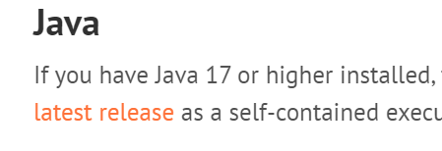
Setting Up Zipkin Server
Click on latest release to download
Download Zipkin server from https://zipkin.io/pages/quickstart
Run the zipkin server by running following in power shell.

Slide 53
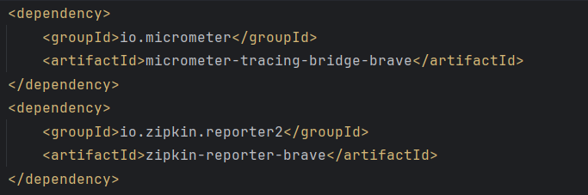

Setting Up Zipkin Server
Add the following dependency to pom.xml
Add the following to application.properties

Slide 54
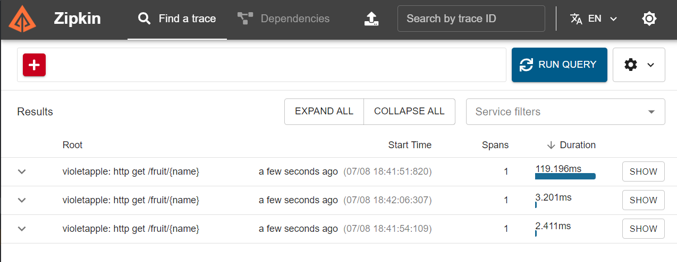
Zipkin Dashboard
After doing API calls click on run query
Api calls
URL for accessing Zipkin server: http://127.0.0.1:9411/zipkin/
Duration of api call

Slide 55
Introduction to Swagger
An open-source framework for API development
Provides a standardized way to describe, produce, consume, and visualize RESTful web services
The Swagger ecosystem includes several tools: Swagger UI, Swagger Editor, Swagger Codegen
8 May 2024, Speaker name

Slide 56
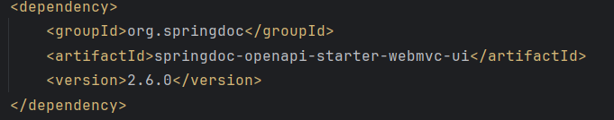
Setting Up Swagger
Add the dependency to pom.xml

Slide 57
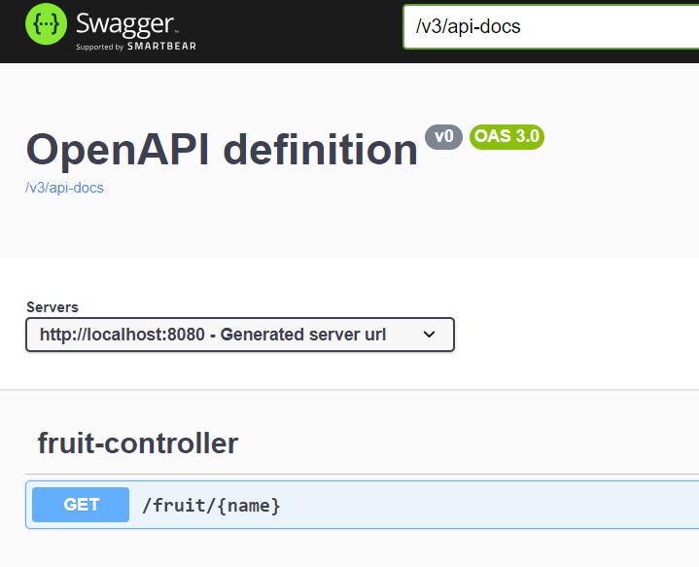
The view
Url for swagger: http://localhost:8080/swagger-ui/index.html
API’s will be listed here

Slide 58
Spring Basics

Slide 59
Blog Application

Slide 60
Spring Data

Slide 61
Spring Boot Creating REST APIs

Slide 62
Spring Boot Testing Lab: Testing Fitness Application

Slide 63
Programmer to API Developer Sandbox

